Slide 1

Topic
ONLINE BANKING SYSTEM
COURSE NAME = JAVA PROGRAMMING
COURSE CODE = E1UA307C
Team Members:
Prakhar Sharma -24SCSE1010069
Aman Verma -24SCSE1010580
Krishna Bhardwaj -24SCSE1010470

Slide 2



Slide 3


Slide 4
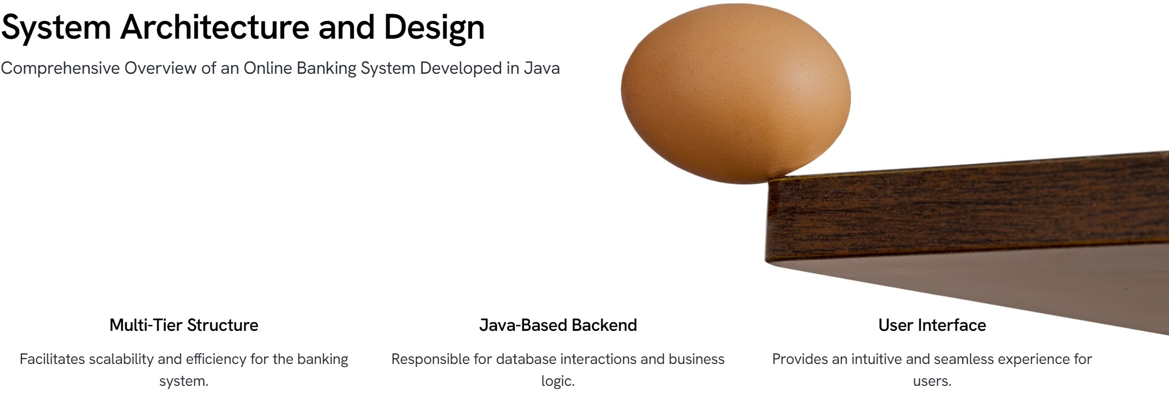

Slide 5
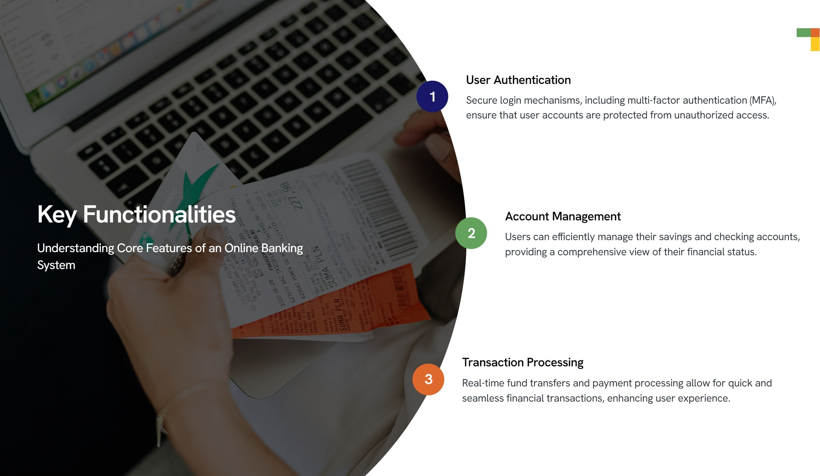

Slide 6
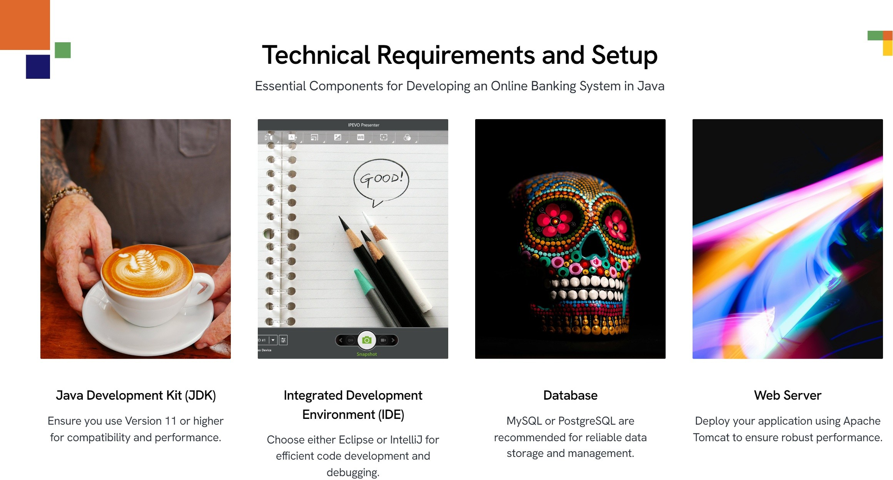

Slide 7
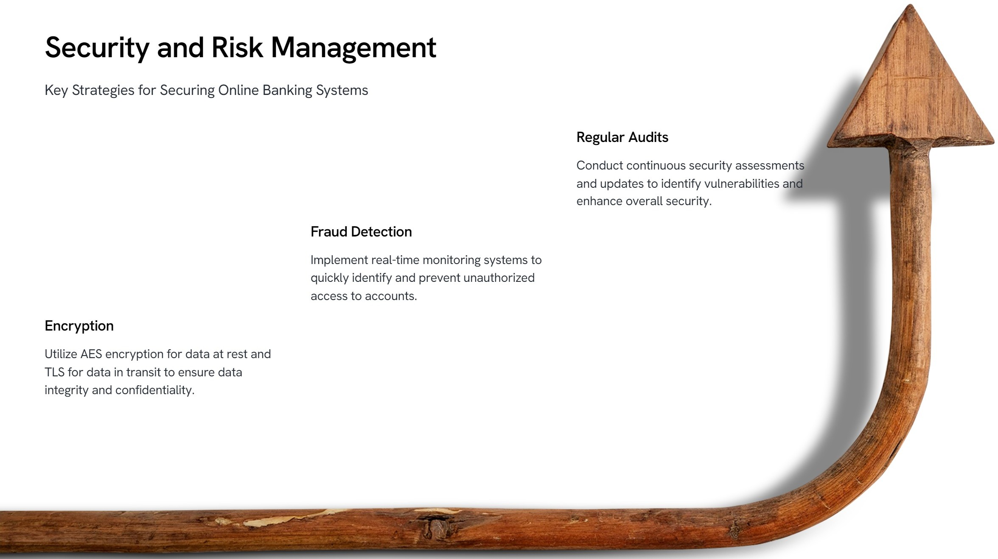

Slide 8
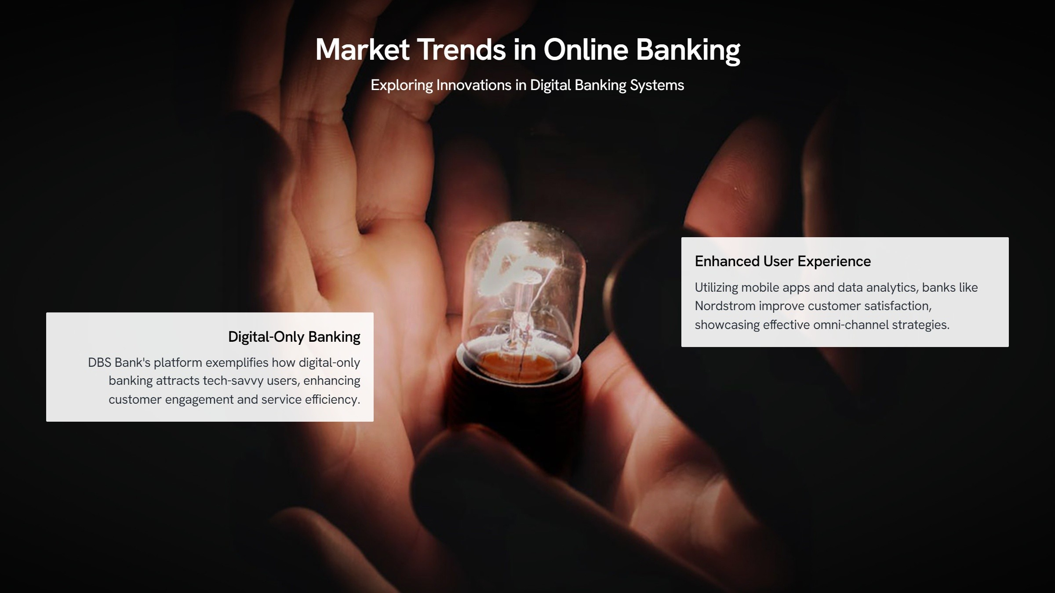

Slide 9
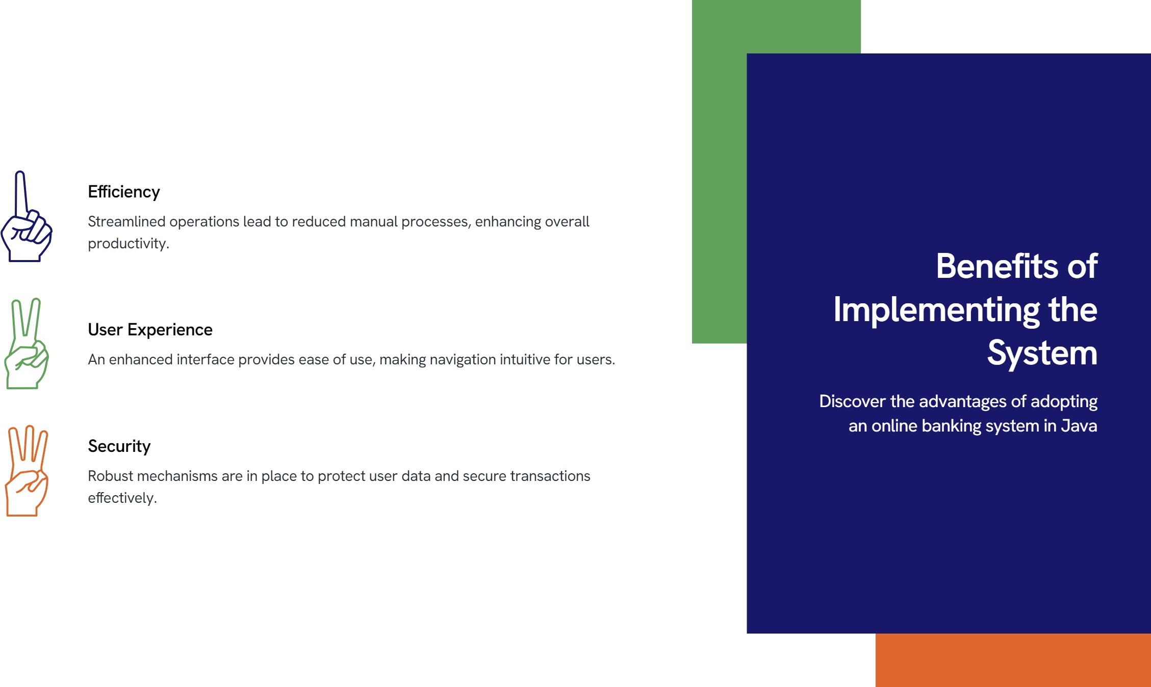

Slide 10
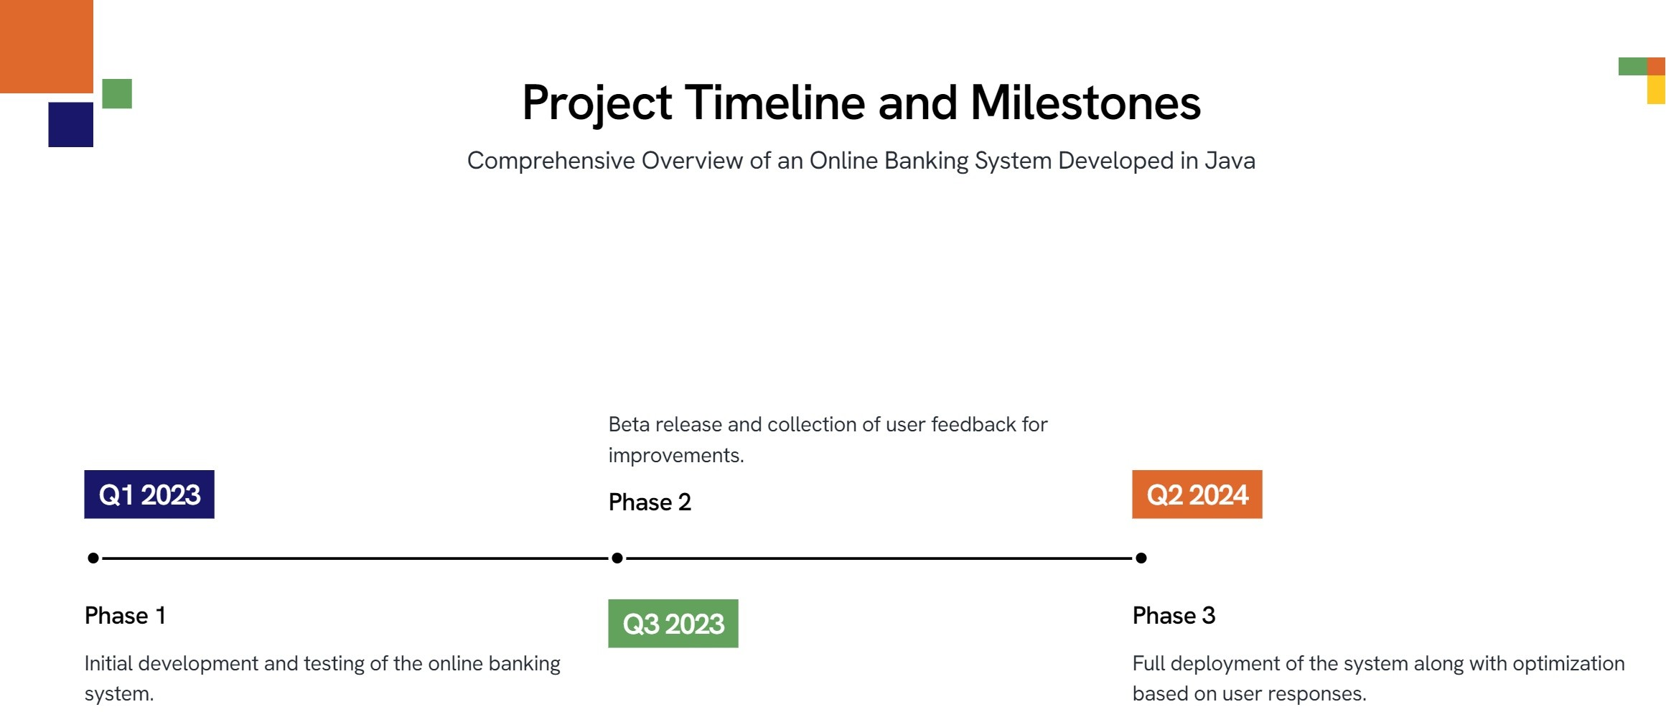

Slide 11


Slide 12


Slide 13


